Slide 1
Final Project
Presentation
Alonzo Dority, Chris Barton, Jaime Chusid, Shola Thompson
Notes:
Hello everyone, Thank you for the opportunity to present group 11’s final presentation, a collaboration by Alonzo Dority ...

Slide 2
Our Topic
Predicting The Best Purchase Price for Agriculture Commodities
A Machine Learning Purchasing Model that Informs Food Manufacturers When to Buy Raw Materials

Slide 3
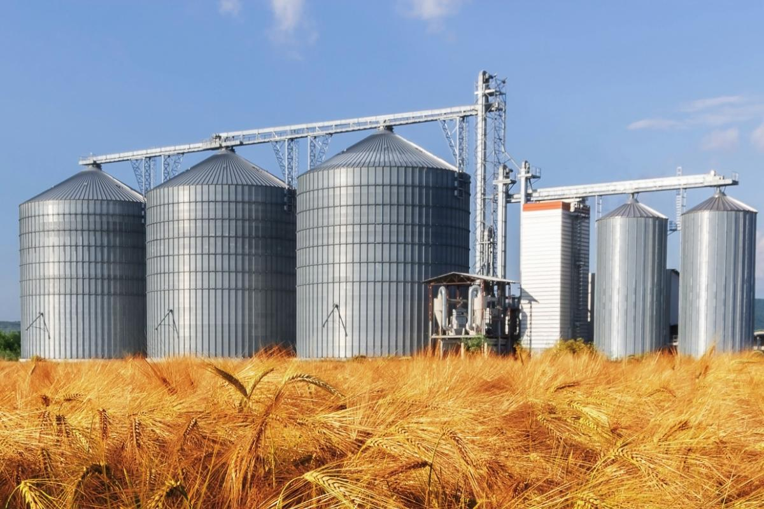
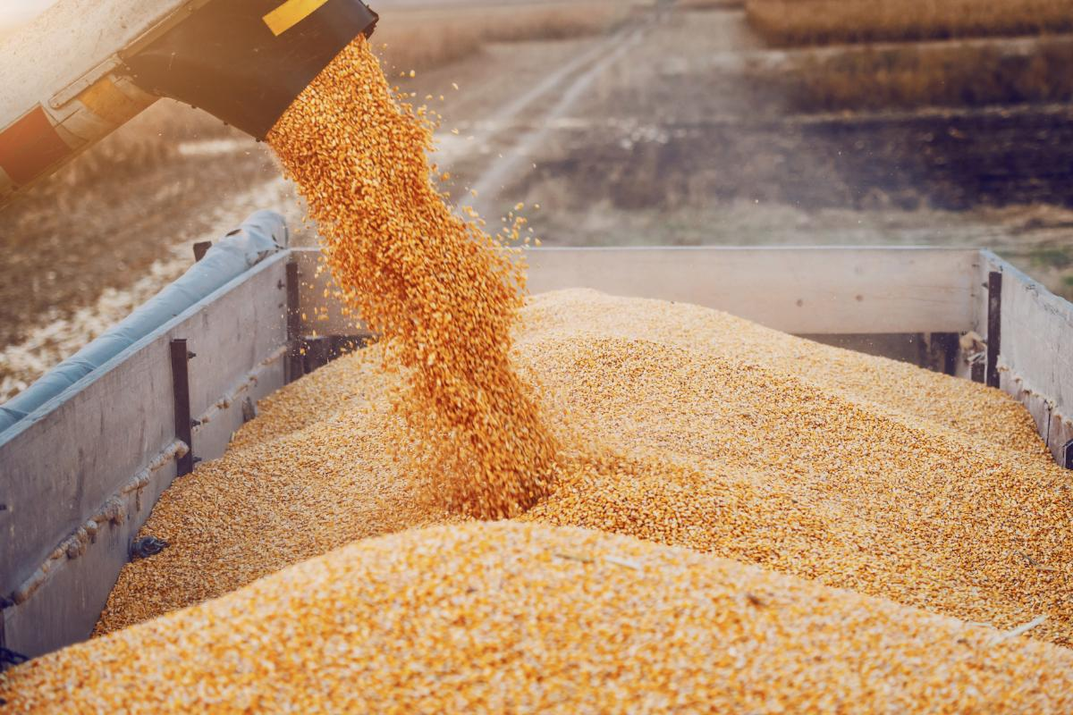
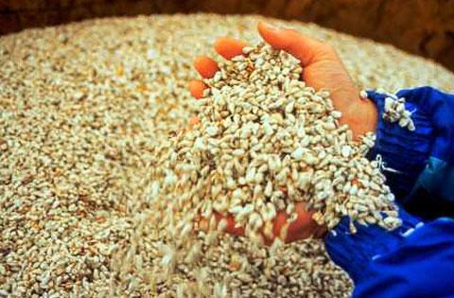
Background: Maintaining the Competitive Advantage
Sugar, Soybean Oil, Soybeans, Wheat, Cotton and Corn are raw materials integral to food production
Purchasing raw materials at the best price maintains a Food manufacturers’ competitive advantage and increases their profitability.
Notes:
Agricultural commodity goods, like Sugar, Soybean Oil, Soybeans, Wheat, Cotton and Corn are raw materials that are integral to production of many manufacturers’ end product items.
Food manufactures face a lot of pressure to keep costs stable and maintain a competitive advantage. To keep costs stable and maintain profit margins, they have to be skilled at purchasing commodities at the optimal price by having a reliable way to decide whether to buy or not. Therefore the purpose of this project is to create a predictive model for Food Manufacturers to inform when to buy, ideally by at a reduced cost, to maintain or increase their profit margin.

Slide 4
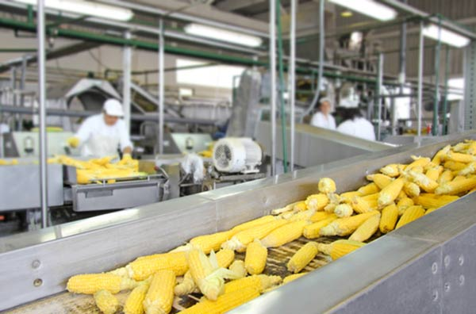
COVID-19 Created The Need For New Purchase Models
COVID 19 increased market variability through supply and demand of the global economy.
Food manufactures are being forced to rethink the way they purchase and procure raw materials based on COVID-19 trends
Notes:
Within the Food and Beverage Manufacturing industry, agricultural commodities / raw materials account for 55 cents of every dollar spent to manufacture the end product With such a high ratio, it is imperative that manufactures know the right price to buy raw materials.
Further, the continuing impact of COVID-19, has resulted in reduction in demand, thus resulting in a higher cost derived from increased volume of inventory and storage of unsold end products. In this challenging environment, food manufactures are being forced to rethink the way they purchase and procure agricultural raw materials.
Creating a reliable and standardized way to purchase raw materials is more important than ever before.

Slide 5

Our Aim
To utilize Artificial Neural Network (ANN) modeling to transforming the way food manufacturing companies manage the risk associated with purchasing agricultural raw materials.
Our model will use a time series analysis to instruct:
BUY when cost price is 5% lower than cost 90-days prior.
DON’T BUY when cost price is 5% higher than cost 90-days prior.
Notes:
It is well documented that agricultural commodities are sensitive to market variability through exchange rates, interest rates, and the supply and demand of the global economy. Therefore, our project aims to create an Artificial Neural Network model for purchasing and procurement that will allow food manufacturers to effectively predict, negotiate, purchase and procure raw materials with a clear way of determining when to buy or not

Slide 6
Questions We Aimed to Answer

Slide 7
1
2
Which commodity pricing is able to most accurately predict the others?
How do pricing fluctuations of one commodity predict pricing of the others?
3
4
How do we determine whether to buy these commodities or wait?
What effect did the COVID-19 pandemic have on these trends?

Slide 8
Data

Slide 9
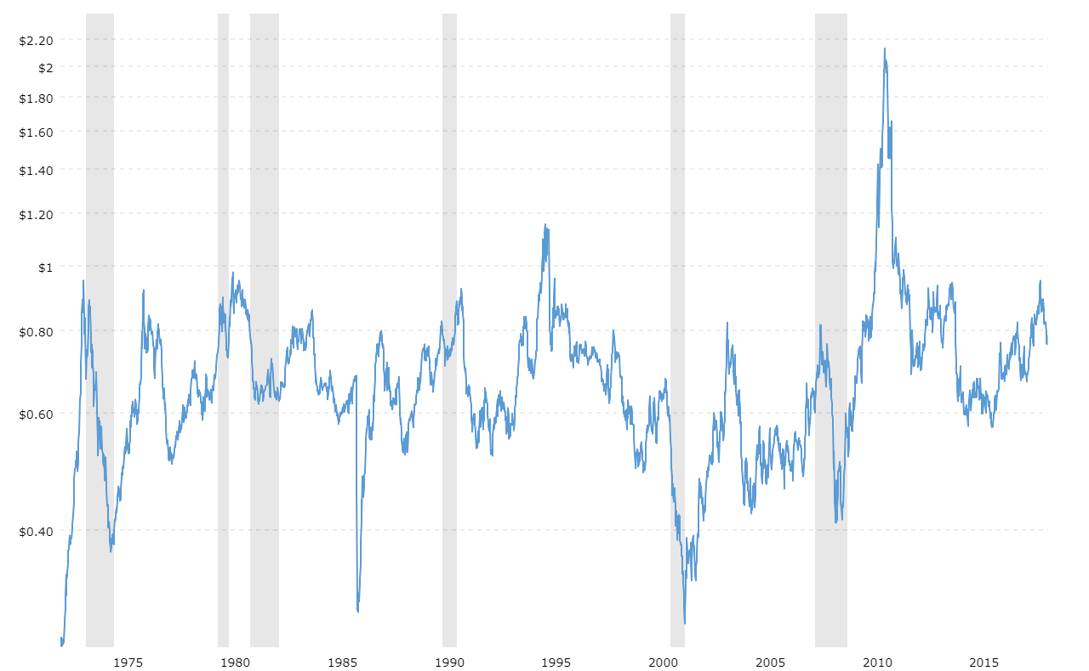
Data Description
Historical commodity futures, foreign exchange and U.S. interest rate pricing data from March 2006 - present
Separate files for cotton, corn, soybeans, soy oil, sugar, and wheat

Slide 10


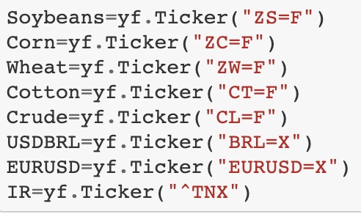
Data Source: Yahoo Finance

Slide 11

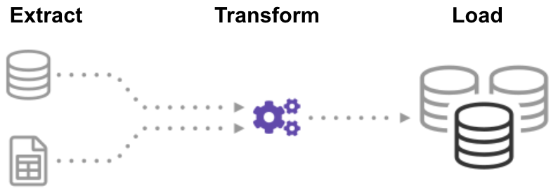
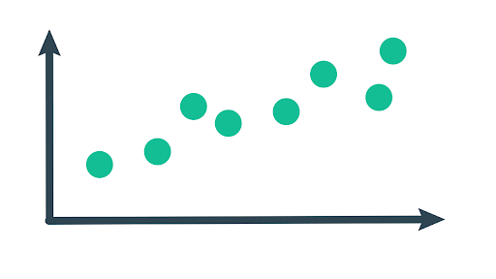
Data Exploration
Cleaning the Data
Finding Patterns
Notes:
Extract - transform - load
Data cleaning:
Made sure all data sources are consistent in data types and columns
Ensured no missing values
Removed irrelevant features and columns
Created new column “trading range” to account for high and low pricing
Finding patterns in data, making sure it all lines up

Slide 12
Analysis

Slide 13
Analysis phase
train
33
features
neural
network
encoding
scaling
test
Notes:
Financial data was used for the analysis and thirty-three (33) total features were created. Data was encoded, then divided using train test split. It was then scaled and fed to our artificial neural network for evaluation.

Slide 14
Artificial Neural Network (ANN)
80 nodes in the first hidden layer
30 nodes in the second hidden layer
1 node in the outer layer
Activation functions: ReLu, ReLu, and sigmoid, respectively
Notes:
The artificial neural network was created with Tensorflow. We experimented with various aspects of the model and settled on a model that used three total layers. The first hidden layer consisted of 80 nodes. The second hidden layer consisted of thirty nodes while our output layer consisted of one node. Our output node makes a binary classification related to the purchasing of select commodities or holding to purchase at a later date. Our first and second hidden layers use a ReLu activation function while the output layer uses a sigmoid activation function.

Slide 15
Artificial Neural Network (ANN)
Compiled using:
a binary crossentropy loss function
An Adam optimizer, with accuracy as the metric.
Trained using 100 iterations to achieve approximately 70% accuracy
The model used a time series analysis to make a binary classification:
BUY or DON’T BUY
Notes:
The network is designed to make a binary classification and uses a binary cross entropy loss function. It also uses an Adam optimization algorithm and uses accuracy as the metric to gauge correct and incorrect classifications
BUY = commodity meets the threshold of cost price 5% lower than 90 days prior.
Don’t Buy = commodity does not meet the threshold of cost price 5% lower than 90 days prior.

Slide 16






Technologies Used
Notes:
Jupyter Notebook, Pandas, Matplotlib, Sklearn, Python, Tensorflow, Yfinance , Tableau, GitHub
The analysis was conducted using a number of technologies used throughout the bootcamp. It was primarily performed in python using a Jupyter notebook. Data was retrieved from a mongodb and loaded into a notebook with pandas. Results were acquired using an artificial neural network with the tensor flow platform. All data was then uploaded into our GitHub repository. In addition, the analysis used other platforms, including Tableau, scikit-learn, Matplotlib, and Yahoo Finance

Slide 17
Results

Slide 18
Model Accuracy by Commodity
The predictability of the models varied per commodity as expected, with the strongest results being in Soybeans and Soy Oil.
Cotton: 0.672
Corn: 0.667
Soybeans: 0.710
Soy Oil: 0.706
Wheat: 0.678
Sugar: 0.606
Notes:
We ran our analysis 6 times, once for each commodity. Below are the respective accuracy scores. As you can see, all models achieved around 60-70% accuracy, with the strongest results being in soy benas and soy oil

Slide 19
Moving Forward
Notes:
Moving forward with this analysis, we have a few recommendations for anyone that would like to create a similar analysis in the future, or even build off of this one. in hindsight, there are some things we could have done differently as well

Slide 20

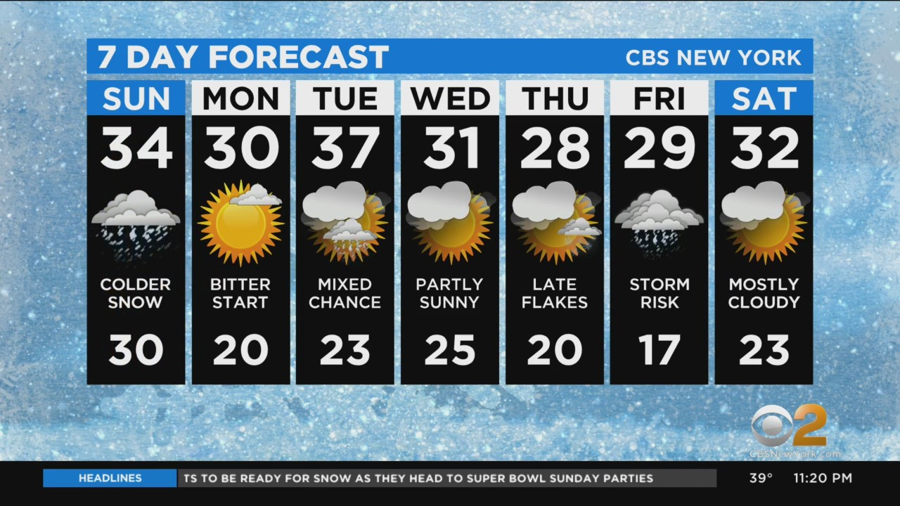
Recommendations for Future Analysis
Include Japan’s currency, Yen, in addition to the US dollar and Euro
Adjust the model to also predict future pricing
Include other external factors, such as climate or time of year
Notes:
Our first recommendation for a future analysis is to include Japan's currency, the Yen. The Yen ranks third as the world’s most used currency, behind the U.S. dollar and Euro, which we have included in our analysis. However, we were unable to access open source historical stock data for Yen currency.
Second, the model can be adjusted to predict pricing for a commodity, rather than making a buy or hold decision. With the time constraints of this project, we did not believe this was feasible, but could be done in the future.
Lastly, we recommend including external factors such as climate or time of year. These factors could provide more insight into the changing stock prices.

Slide 21

What We Could Have Done Differently
Include the historical pricing of crude oil in our analysis
Look back further than 90 days to determine buy or don’t buy
Notes:
In terms of what we could have done differently, research shows a link between crude oil prices and agricultural commodities price indexes. Looking back, we should have included historical stock data for crude oil to more accurately predict commodity pricing
Additionally, we could have looked at more than just the past 90 days of pricing to make a buy or hold decision. Looking at the time of year and patterns that may have occurred in prior years may offer more insight into the future stock prices of the commodities

Slide 22
Thank You!

